Slide 1
An Introduction to
Reinforcement Learning
By Christopher Torrington

Slide 2
Talk about training dogs

Slide 3
Not doing GPI – doing eval & iteration separately. No Dynamic programming

Slide 4
Emphasise these things Tabular solution method
FINITE MDP (set of S,A,R have FINITE number of elements)

Slide 5
Markov Decision Process

Slide 6
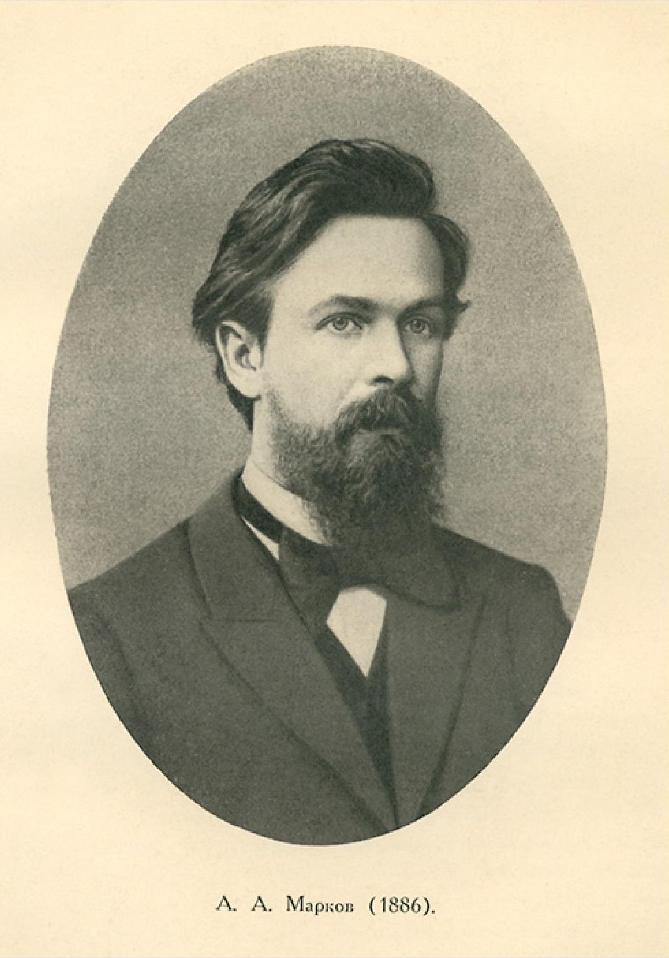
Andrey Markov
Notes:
The name of MDPs comes from the Russian mathematician Andrey Markov as they are an extension of Markov chains.

Slide 7
Main
Space
Reward
+
0.5
Academy Room
1
No reward
0
Outside
- reward

Slide 8
Agent-Environment Interactions
p(s’, r | s, a) ≐ Pr{ S_{t} = s’, R_{t} = r | S_{t - 1} ≐ s, A_{t - 1} = a }
S₀
A₀
R₁
S₁
A₁
R₂
S₂
A₂
R₃
S₃
A₃
R₄
…

Slide 9
Goals & Rewards

Slide 10
Returns & Episodes

Slide 11
Rewards
R_{t+1}
R_{t+2}
R_{t+3}
R_{t+4}
…

